Slide 1

YAML Lecture-2
www.corvit.com

Slide 2
Topics
Escape Character
Anchor & Extensions
Placeholders
Structures / Multiple Files
Tags
Yaml Processing
Examples
www.corvit.com

Slide 3
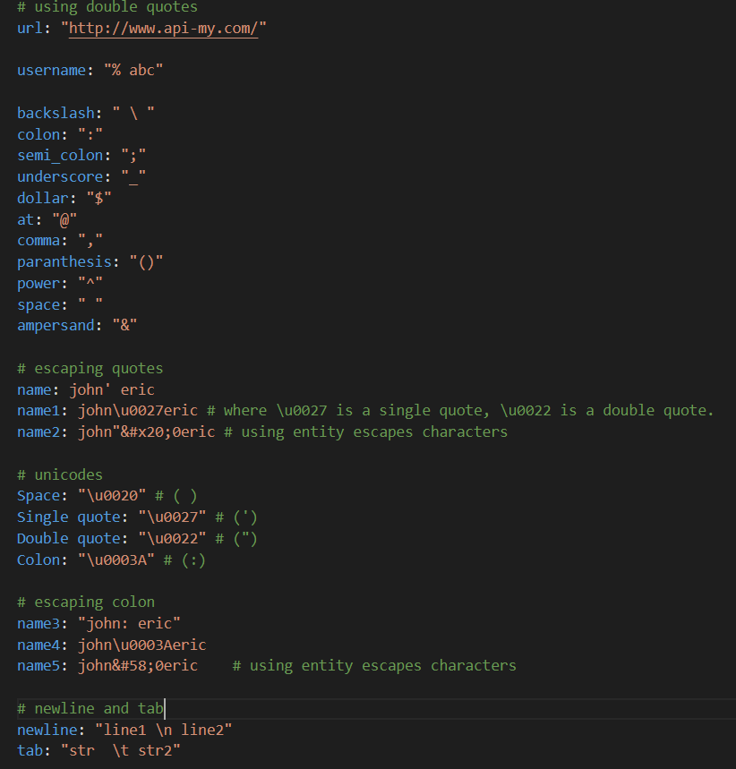
Escape Character
Characters are easily added to yaml for reading.
Normal strings are represented in yaml values as a string. But you need to enclose in double quotes for escape characters or use Unicode enclosed in quotes.
Special characters: ( %,\, { },(),_,- , : [] & * ?,%
space : ( )
tab: ( \t )
line break character: ( \n )
The quote character: ( ' ' )
The double quote character: ( “)
www.corvit.com

Slide 4
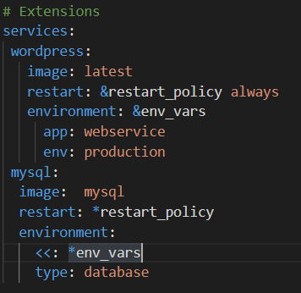
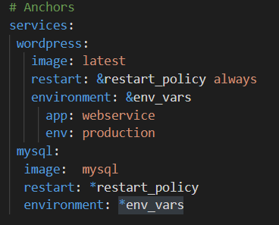
Anchors & Extensions
Anchors
Extensions
Yaml Anchors are a feature which let you identify an item and then reference it elsewhere in your file.
Anchors are created using the (&) sign followed by an alias name.
We can use this alias later to reference the value using * sign.
Yaml Extensions extends the Anchor values to add additional values.
www.corvit.com

Slide 5
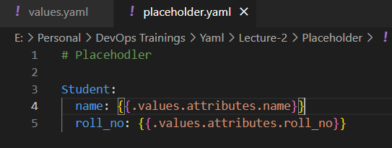
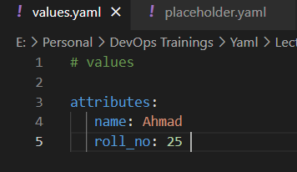
Placeholders
Yaml Placeholders are used to reference variables inside the Yaml Files.
Avoid hardcoded values
Helm uses these Placeholders for templating Kubernetes Yaml files and by using Go templating Engines, these Placeholders are replaced by Real Values.
www.corvit.com

Slide 6
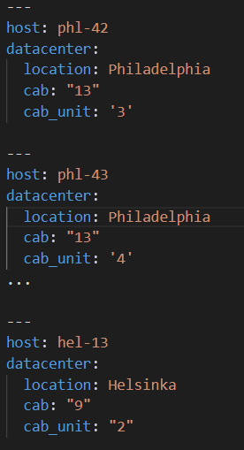
Structures / Multiple Files
All Yaml files can optionally begin with --- and end with … which indicates the start and end of a document.
Multiple Yaml documents can be clubbled in a single file by separating them with ---
The Yaml parsers will recognize each set of dashes as the beginning of a new document.
www.corvit.com

Slide 7
Tags
Tags can use one of three purposes within a YAML file that is described below:
We can utilize tags to set a custom URI (universal resource indicator), which is used to reference our tags.
We can also use them to set local tags. Local tag is a tag that is relevant only to the existing YAML file. If we include a local tag in the body of our file, that tag will also be tagged on to the end of a universal resource indicator (URI).
We can also use tags to set the data type.
www.corvit.com

Slide 8
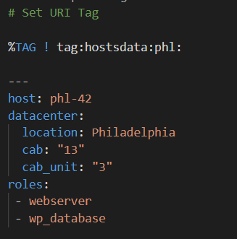
Setting URI Tag
We don't need these URI tags for any configuration management or just configuration file settings that were using YAML. However, if we are using YAML as a data store for an application we are creating, the URI tags are useful.
URI tags are useful if we use conjunction or JYAML or whatever YAML API is available with our programming language.
The custom URI that we want to set ends up in the metadata area of our host file or any YAML file.
So the URI will set above our three-dot start document indicators. We first define a URI tag by adding the % (percent sign) and Tag indicator, and then we can go ahead and add an exclamation point (!), which is going to work as a prefix to the local tag.
Syntax : %TAG ! prefix
www.corvit.com

Slide 9
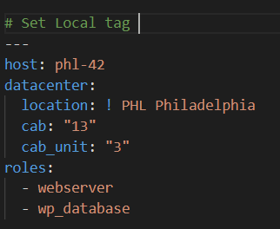
Setting a Local Tag
Now we go ahead and set a local tag to our document. To do this, we are using the Philadelphia location. We assign the exclamation point(!) and PHP tag before Philadelphia, which denotes that we are working in location Philadelphia.
Now when we reference this, we will call it tag:hostsdata:phl:PHL. That's all we will do to set a local tag, and then we will be able to reference the tag.
www.corvit.com

Slide 10
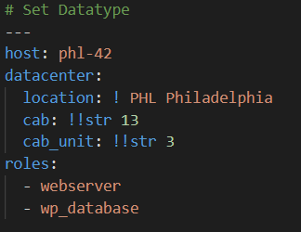
Set Datatype
We can also utilize a tag to change the functionality of how are parser read our YAML. Now we set our cab and cab_unit to string without using quotes because YAML does not involve quotes ("").
Using tags, we can change the data type. To do this, we will use two exclamation points(!!), after that, we go ahead and set our data type
We can also change it into different data types like sequence, mapping, etc. When we are working in a specific language like Python, Ruby, then that language or that program has an additional set of data type tags we can reference.
www.corvit.com

Slide 11
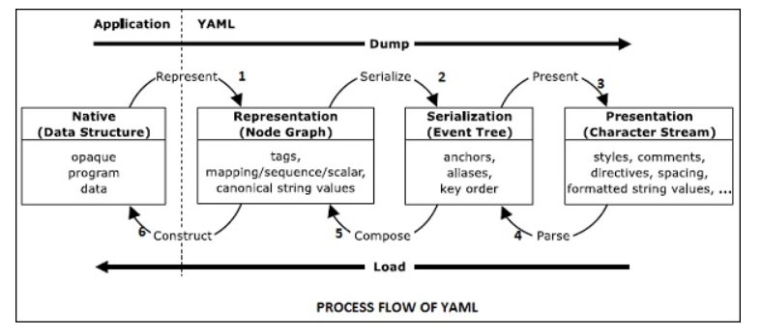
YAML Processing
YAML includes a serialization procedure for representing data objects in serial format. The processing of YAML information includes three stages: Representation, Serialization, Presentation and parsing. Let us discuss each of them in detail.
www.corvit.com

Slide 12
Representation
YAML represents the data structure using three kinds of nodes: sequence, mapping and scalar.
Sequence: Sequence refers to the ordered number of entries, which maps the unordered association of key value pair. It corresponds to the Perl or Python array list.
Mapping: Mapping on the other hand represents dictionary data structure or hash table
Scalar: Scalars represent standard values of strings, integers, dates and atomic data types.
www.corvit.com

Slide 13
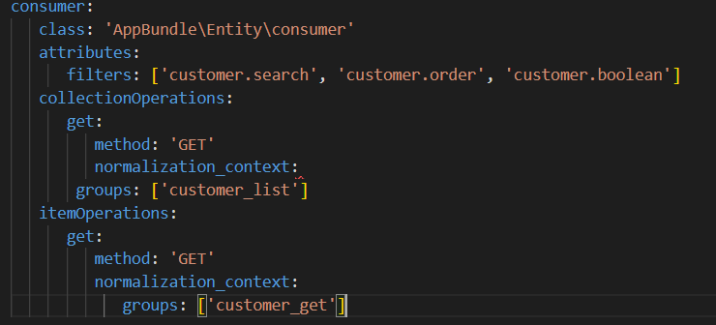
Serialization
Serialization process is required in YAML that eases human friendly key order and anchor names. The result of serialization is a YAML serialization tree. It can be traversed to produce a series of event calls of YAML data.
www.corvit.com

Slide 14
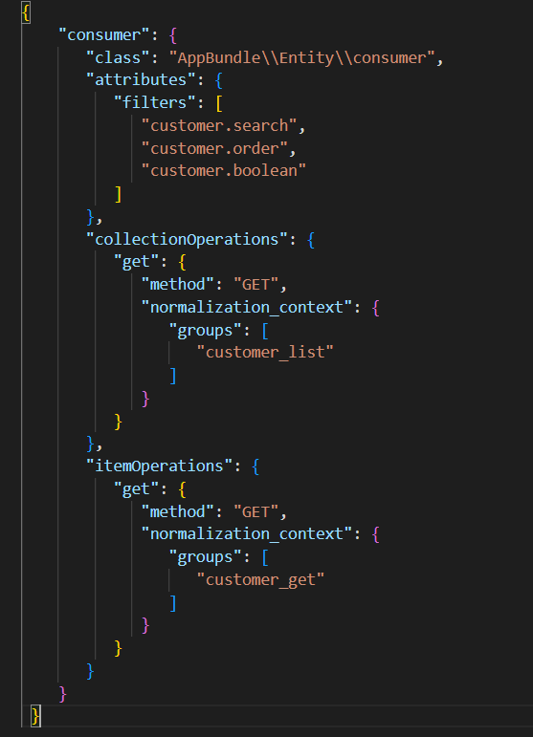
Presentation
The final output of YAML serialization is called presentation. It represents a character stream in a human friendly manner. YAML processor includes various presentation details for creating stream, handling indentation and formatting content. This complete process is guided by the preferences of user.
An example for YAML presentation process is the result of JSON value created
www.corvit.com

Slide 15
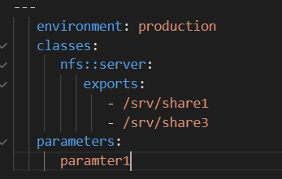
Parsing
Parsing is the inverse process of presentation; it includes a stream of characters and creates a series of events. It discards the details introduced in the presentation process which causes serialization events. Parsing procedure can fail due to ill-formed input. It is basically a procedure to check whether YAML is well-formed or not.
www.corvit.com

Slide 16
Examples
www.corvit.com

